Slide 1
Quality Assurance (Software Testing)
A Hands-on Training organized for BIOSEC Solutions

Slide 2

Divider slide
Whats is QUALITY?
The degree to which a component, system or process meets specified requirements and user/customer needs and expectation.
Quality products/services help to maintain customer satisfaction and reduce risk and cost of replacing faulty goods or revoked services

Slide 3
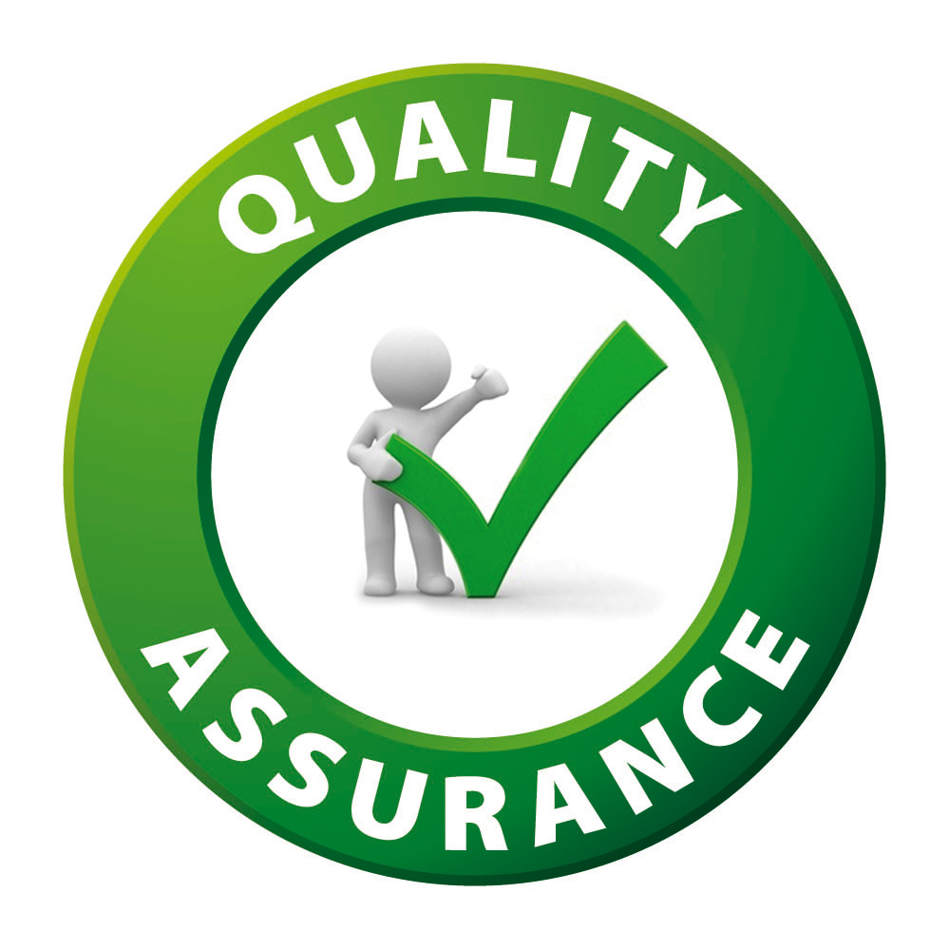
Divider slide
What is QUALITY ASSURANCE?
Quality assurance (QA) is a way of preventing mistakes and defects in manufactured products and avoiding problems when delivering solutions or services to customers
(Wikipedia)

Slide 4
Divider slide
What is QUALITY ASSURANCE?
"part of quality management focused on providing confidence that quality requirements will be fulfilled"
- ISO 9000

Slide 5
What is Software Testing?
Testing is a process consisting of all life cycle activities, both static and dynamic, concerned with planning, preparation and evaluation of software products and related work products to determine that they satisfy specified requirement to demonstrate that they are fit for purpose and to detect defects.

Slide 6
Why is Testing Important?
Testing is necessary because we all make mistakes, some of those mistakes are unimportant, but some of them are expensive or dangerous.

Slide 7
Why is Testing Important?
Here are some other reasons why testing is important.
Testing helps us to measure the quality of software in terms of the number of defects found, the tests run, and the system covered by the tests.
Testing can give confidence in the quality of the software if it finds few or no defects, provided we are happy that the testing is sufficiently rigorous.
Testing is important because software bugs could be expensive or even dangerous. Software bugs can potentially cause monetary and human loss.

Slide 8
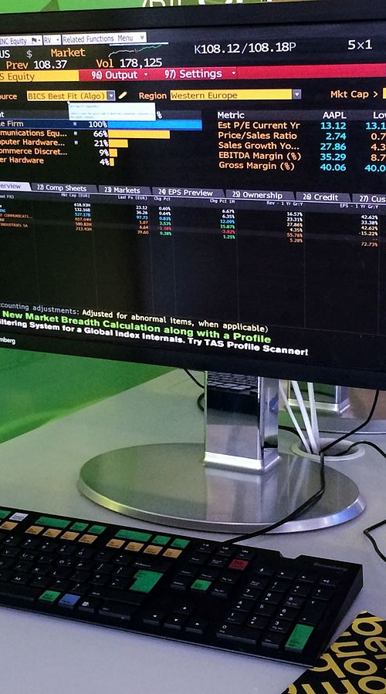
Why is Testing Important?
Lessons from History
In April 2015, Bloomberg terminal in London crashed due to software glitch affected more than 300,000 traders on financial markets. It forced the government to postpone a 3bn pound debt sale

Slide 9

Why is Testing Important?
Lessons from History
Nissan cars have to recall over 1 million cars from the market due to software failure in the airbag sensory detectors. There has been reported two accidents due to this software failure.

Slide 10

Why is Testing Important?
Lessons from History
In May 1996, a software bug caused the bank accounts of 823 customers of a major U.S bank to be credited with 920 million US dollars.

Slide 11
Frequently Asked Questions
Quality Assurance (QA) vs Quality Control (QC)…whats the relationship?
.
Quality Assurance | Quality Control
A procedure that focuses on providing assurance that quality requested will be achieved. | A procedure that focuses on fulfilling the quality requested.
Aims to prevent the defect | Aims to identify and fix defects
It is a method to manage the quality (Verification) | It is a method to verify the quality (Validation)
It is a Preventive technique | It is a Corrective technique
It is a Proactive measure | It is a Reactive measure

Slide 12
What to expect from this Training
Gain valuable insights about Software Testing Trends, Job Opportunities, Career path options, Hiring and Salary Trends etc
Learn about Software Testing from scratch
Master Fundamentals in software testing
Build STLC documents – Test Plan, Test Scenarios, Test Cases etc
Get in-depth Exposure to popular defect management and automation tools used in the industry

Slide 13
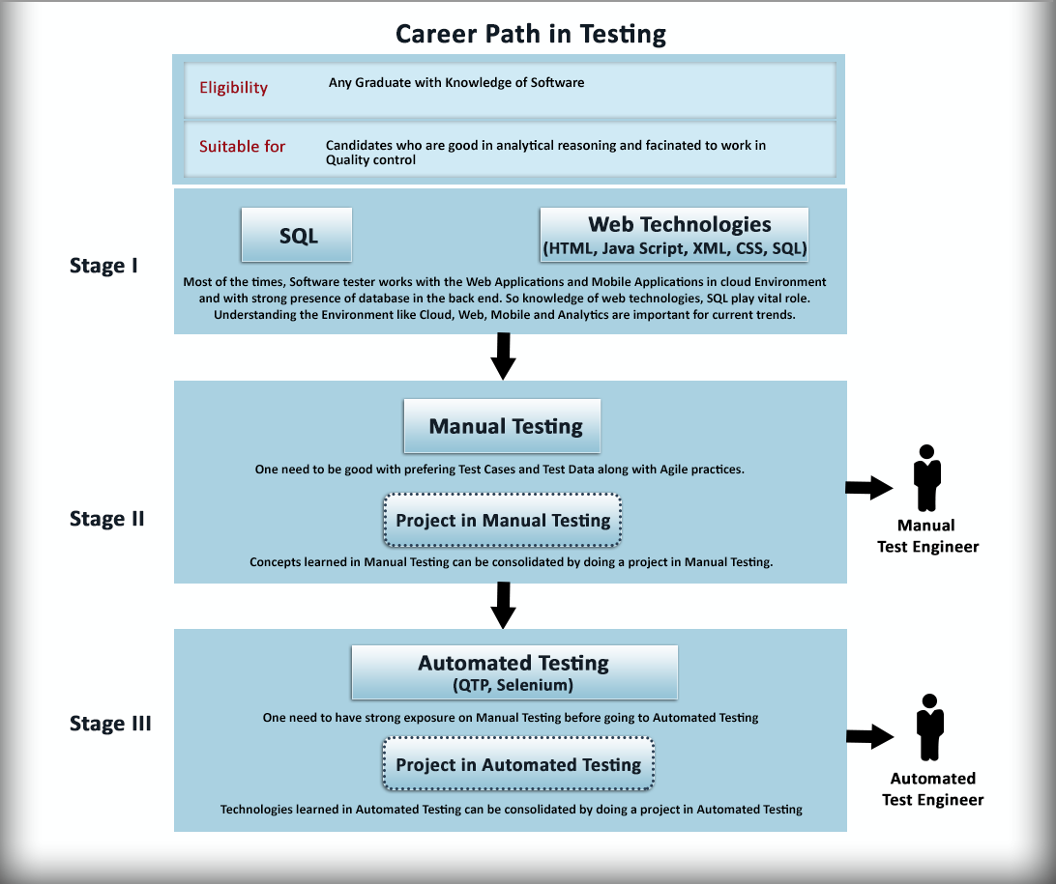
Software Testing Career Options

Slide 14
THANK YOU

